Slide 1
OSM NAVI
Navigation Assistant for Visually Impaired (Open Street Maps)
Arjun Bhardwaj Harman Mehta Tanmay Goyal Utkarsh Agrawal
Mentor -
Mr. Piyush Chanana

Slide 2
Objective
To develop an Android App to help visually impaired persons navigate to their desired destinations
For the purpose of COP315, the app should be
completely functional inside IIT Delhi’s campus

Slide 3
Our Progress So Far
Added Information “TAGS”
Linked Voice Commands
Removed Existing Bugs
Location Biasing
Retrieved Heading Direction
Dynamic Orientation Correction
Added Points of Interests
Testing Phase I
Minor Fixes and Code Optimization
Retrieved Specific Tags
User Interface Overhaul
Testing Phase II

Slide 4
Key Features
Orientation and Tracking
Nearby Points Of Interest
Tags Fetched
Highway (road type
– residential, living street etc.)
Surface (surface type– asphalt, paved etc.)
Lanes (provides number of lanes)
Footway (presence of footpath)
Heading Direction is provided by comparing the phone’s direction and that of the immediate path
The user is informed about his/her progress at one-third, half and two-thirds of the total distance
The app provides information about the nodes surrounding the user (within a bounding box)
The user can access these at any point of time during the journey
Eg: Restaurants, Bicycle stands etc.

Slide 6
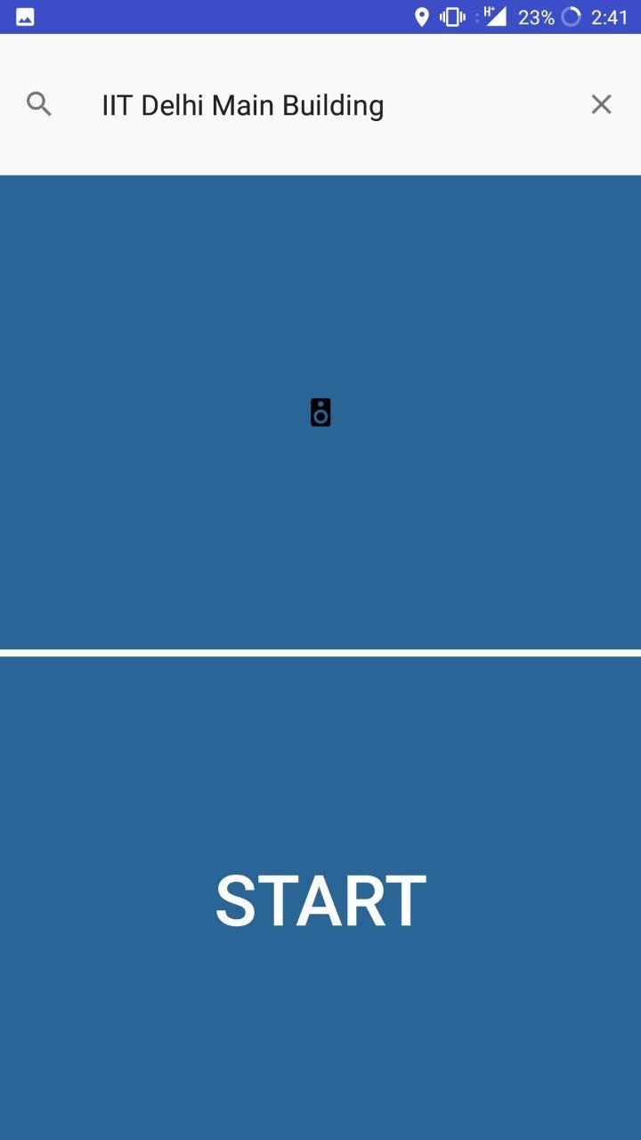
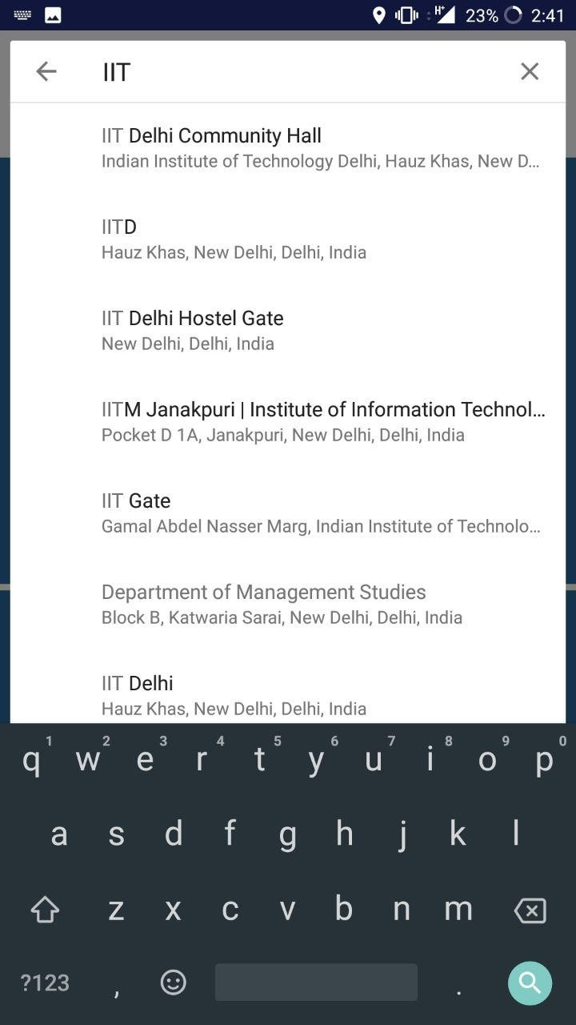
Main Activity (first screen)
Consists of three elements –
Search bar (to enter destination)
Voice button (to provide
voice input from blind user)
Start button (to start
navigation)

Slide 7
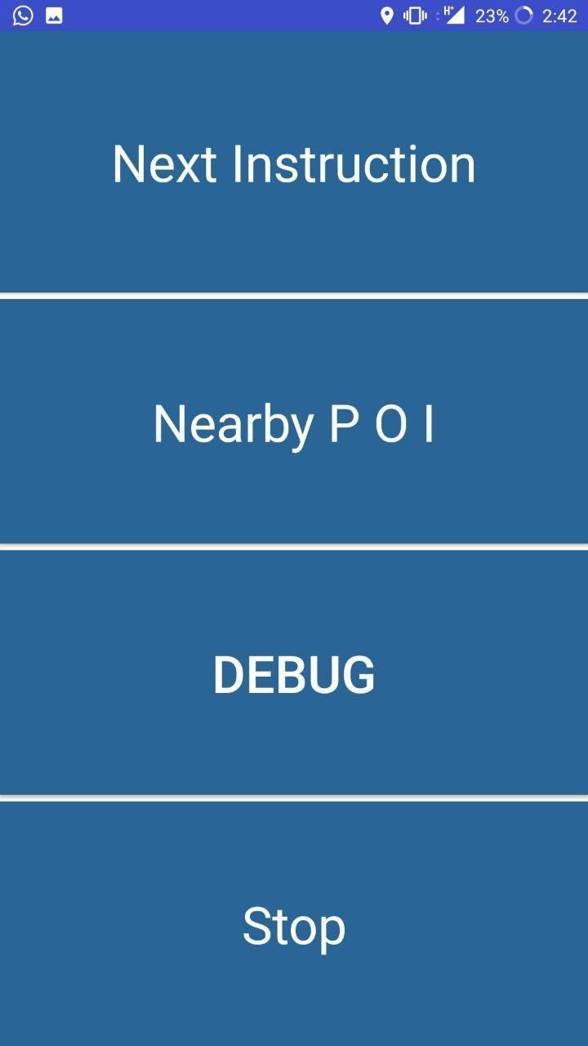
Second Screen
Appears after starting navigation
Four buttons on screen –
1)Next Instruction 2)Nearby POI 3)Debug (testing purpose)
4)Stop

Slide 8
Current Status and Limitations
App can route throughout the IIT Delhi campus
Completely new User Interface has been designed
Most major nodes (and their attributes) inside the campus have been fed into the OSM system
New layout planned for Open House Demo
No work on re-routing capability
Limited number of tags being used and optimised at the moment
Campus is still not EXTENSIVELY detailed in the OSM map
Inefficient algorithm to feed useful information to the user (currently – four tags, nearby nodes)

Slide 9
Demonstration Plan
We are designing a new layout specifically for the demonstration –
App would allow users to explore app features without actually navigating
We will shoot a few videos of users navigating roads inside IIT Delhi –
These video clips will showcase the user-app interaction and its working

Slide 10
GitHub Code:
https://github.com/arbhardwaj98/OSM_Navi

Slide 11
THANK YOU

